Slide 1
Portfolio
Jack O’Melia

Slide 2
Dashboards Tangoe Platform
Legacy Products

Slide 3
Dashboards

Slide 4
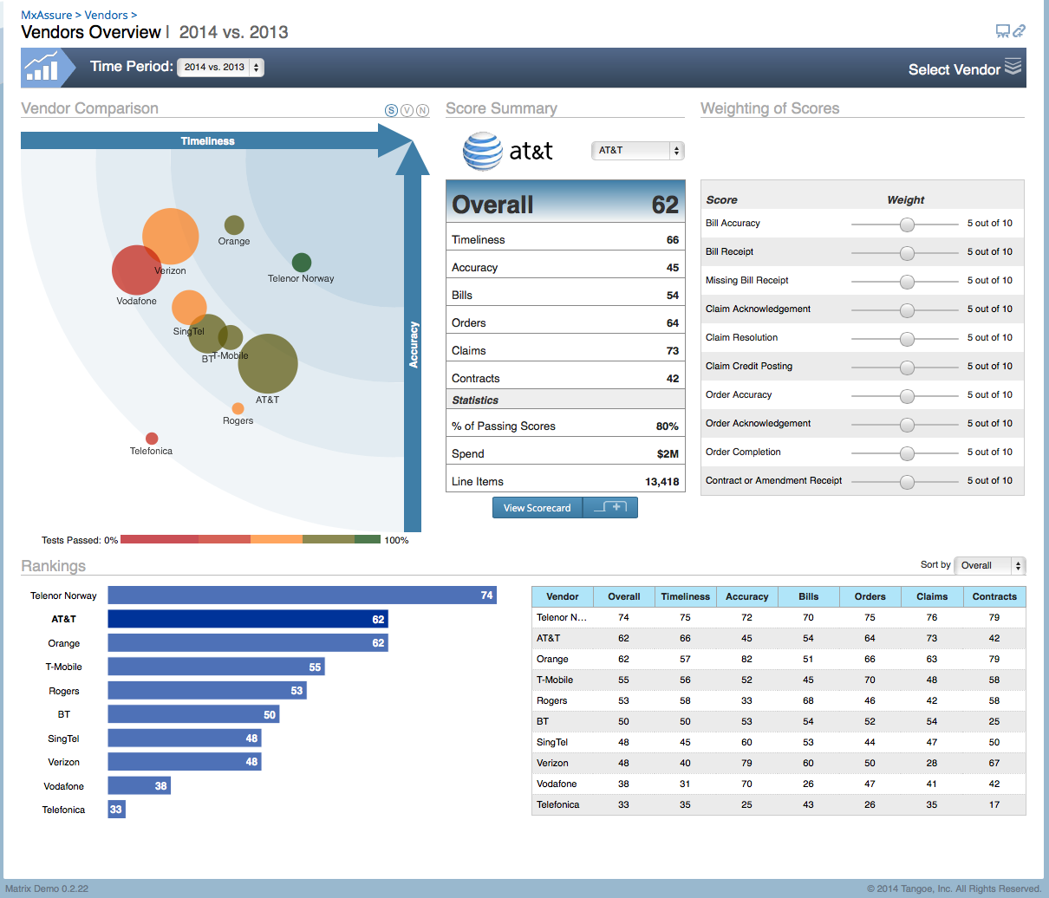
Vendor Comparison

Slide 5
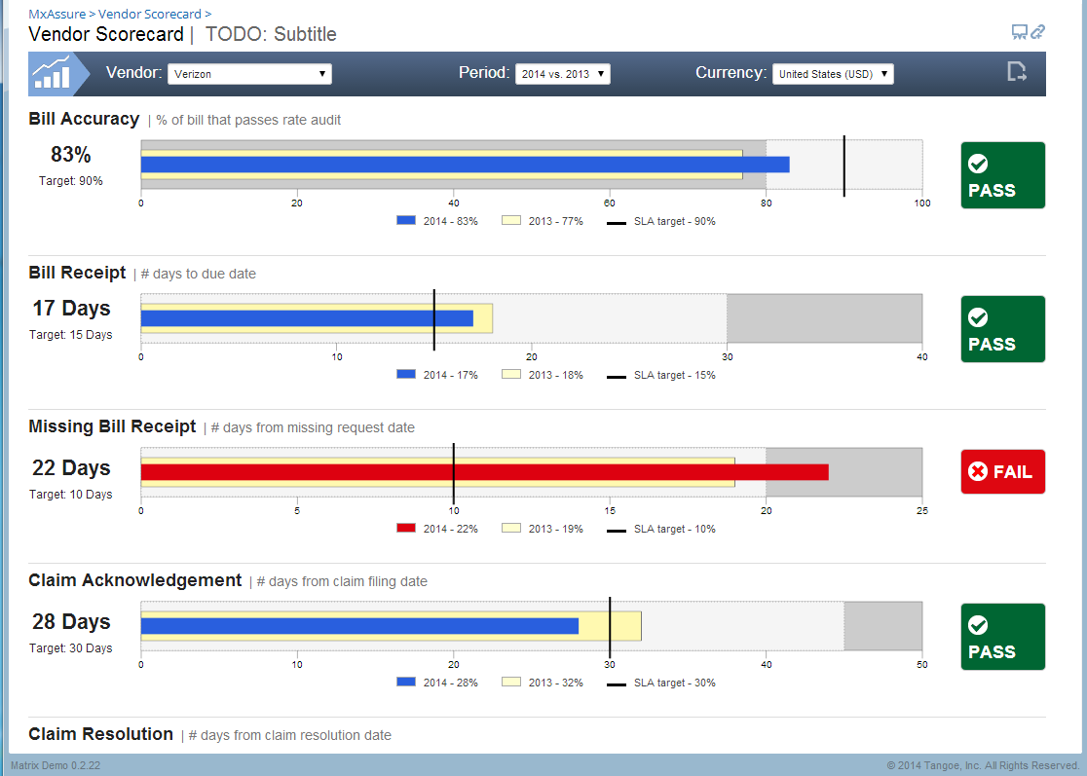
Vendor Scorecard

Slide 6
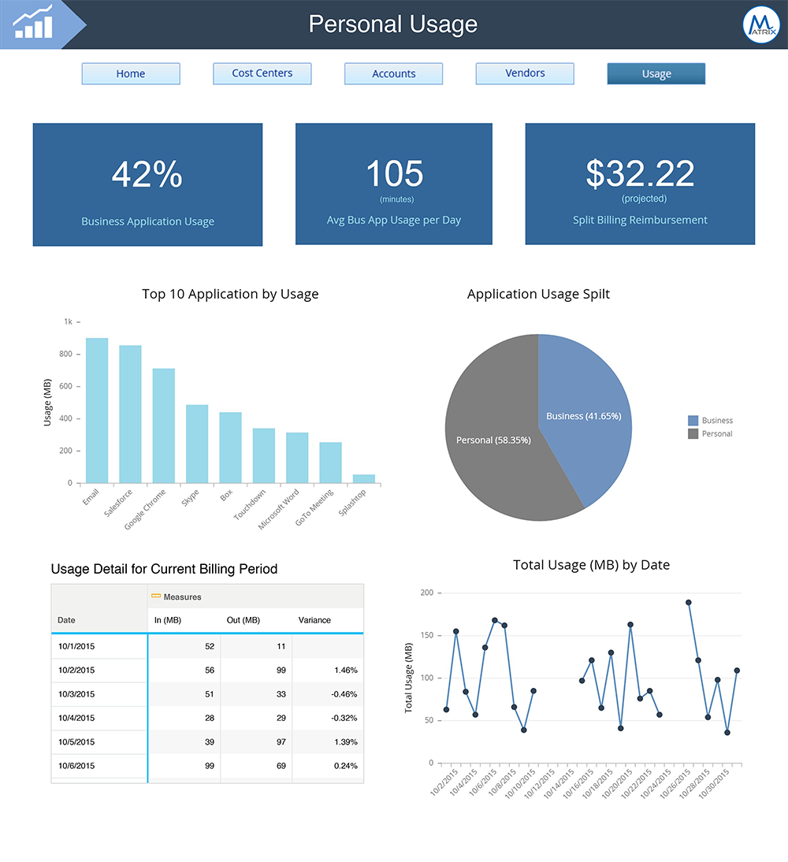
Personal Usage (SAP Lumira)

Slide 7
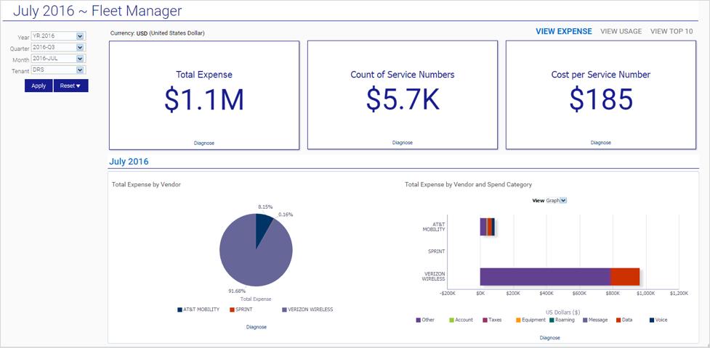
Fleet Manager (OBIEE)

Slide 8
Tangoe Platform
(formerly Matrix/MyMatrix)

Slide 9
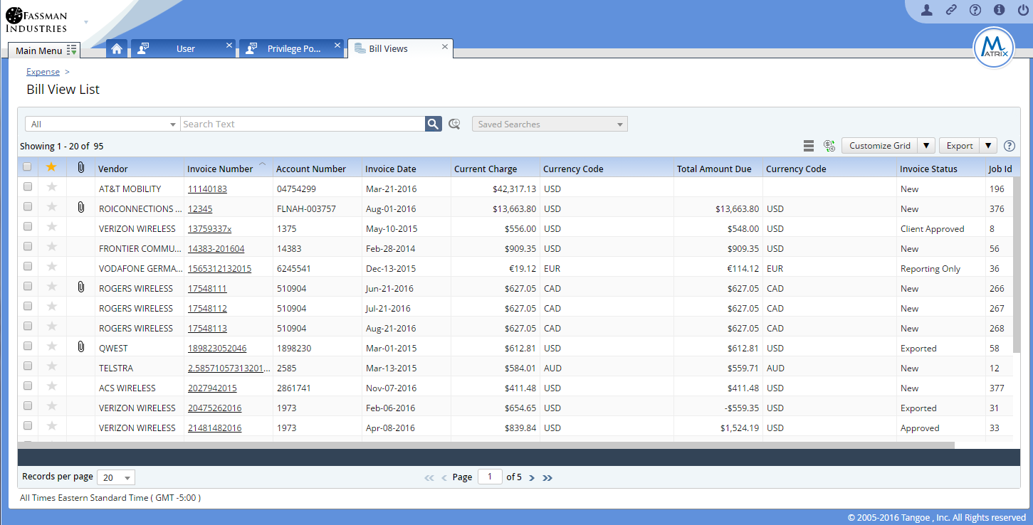
Matrix List (Old)

Slide 10
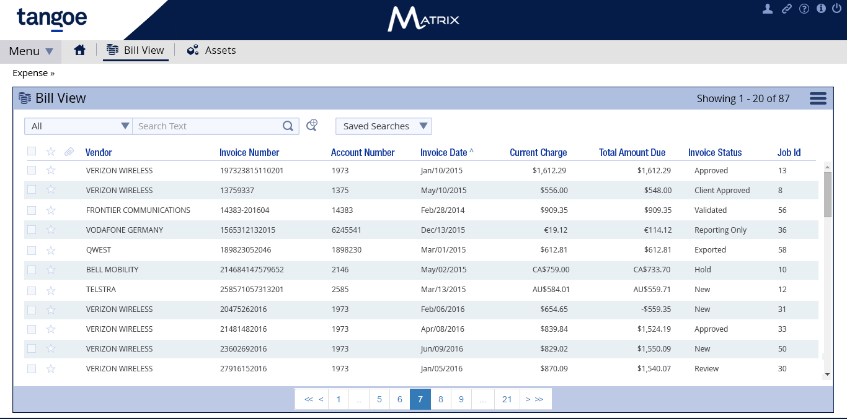
Matrix List (New)

Slide 11
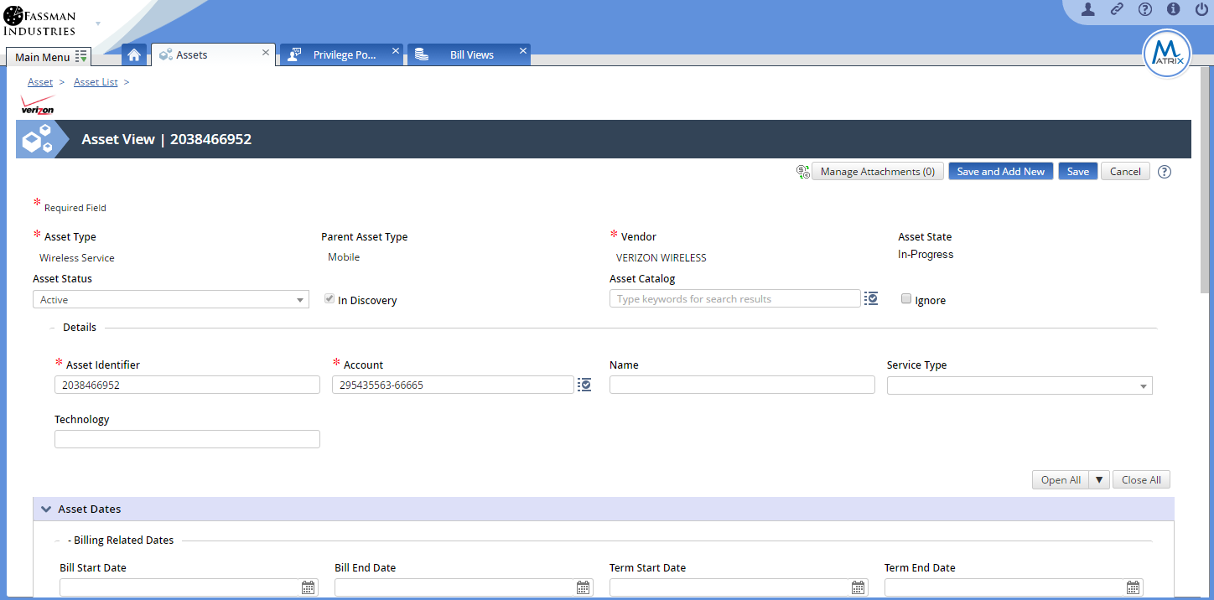
Matrix Detail Page (Old)

Slide 12
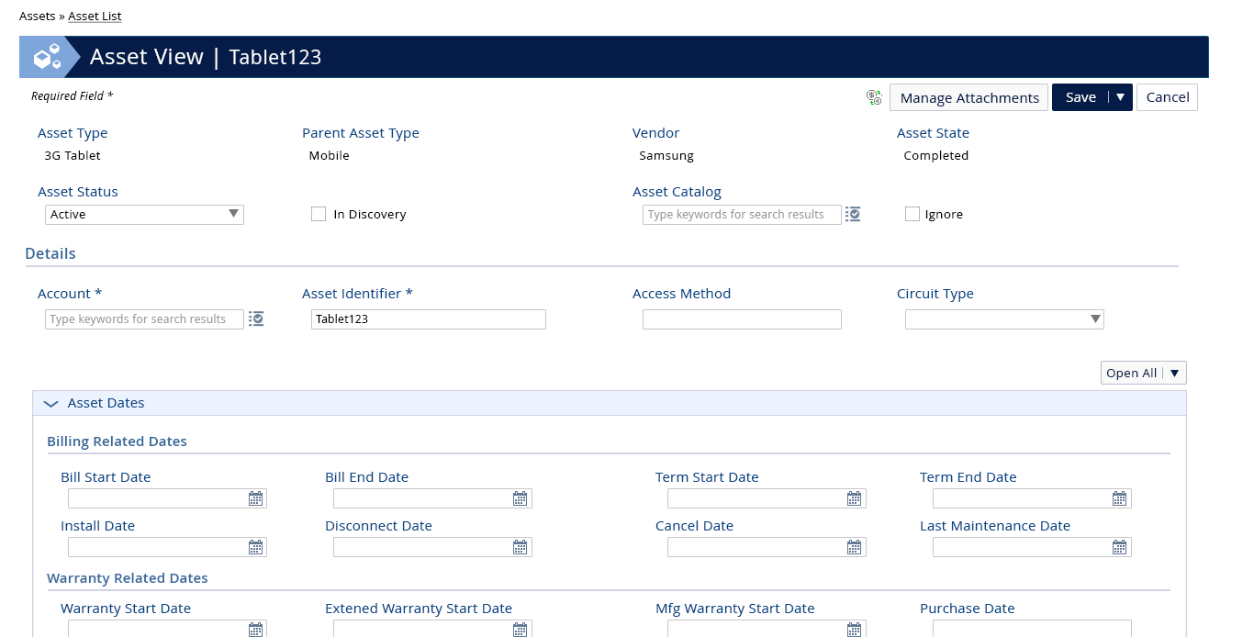
Matrix Detail Page (New)

Slide 13
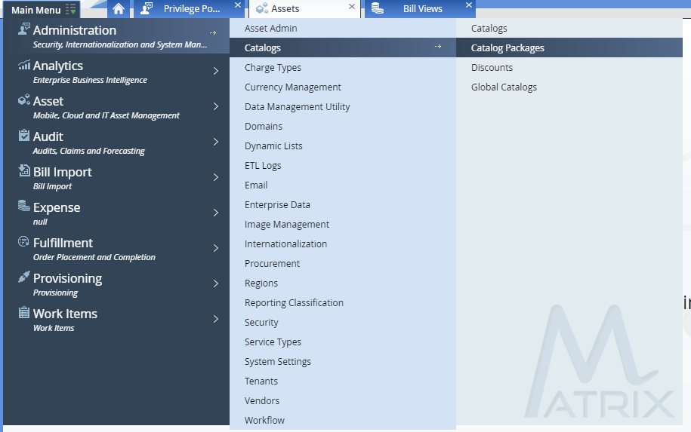
Matrix Menu (Old)

Slide 14
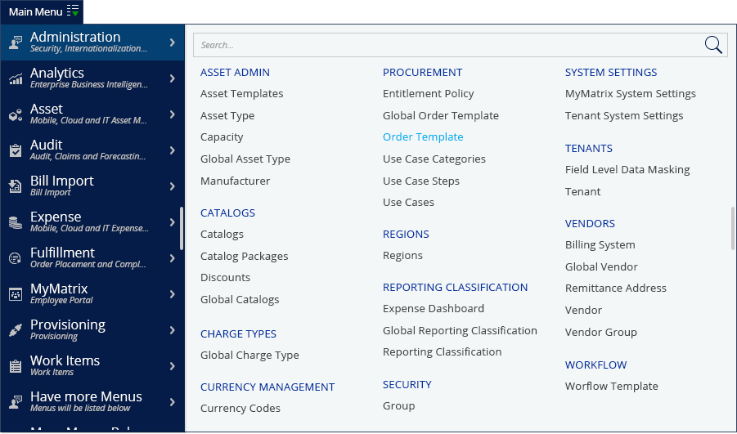
Matrix Menu (New)

Slide 15
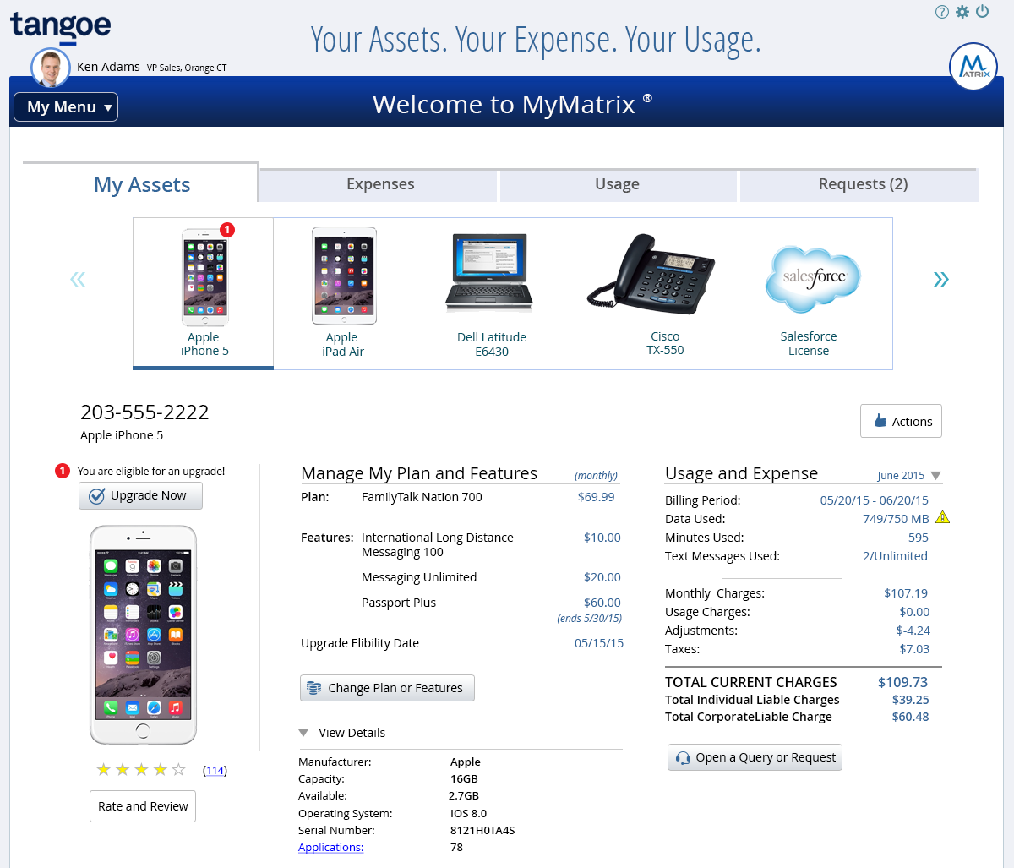
MyMatrix Asset (Old)

Slide 16
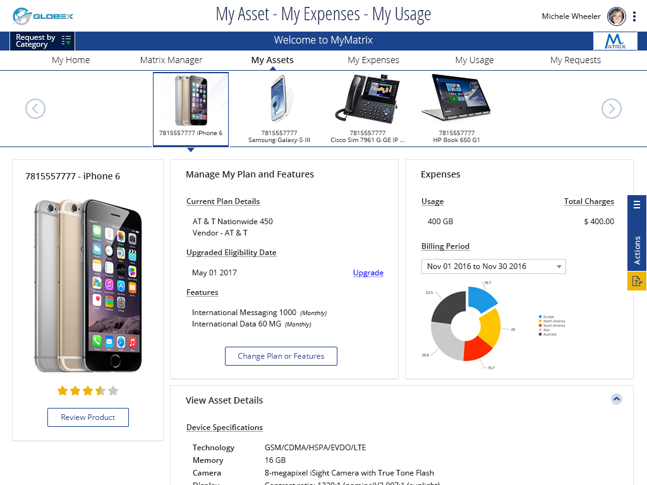
MyMatrix Asset (New)

Slide 17
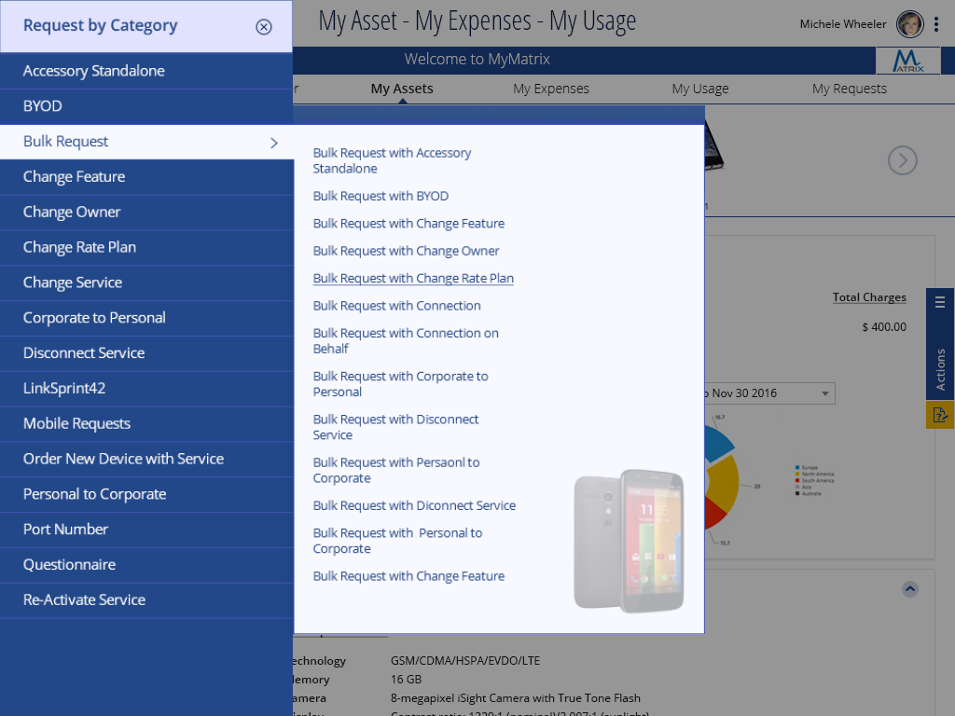
MyMatrix Asset Menu

Slide 18
Legacy Products

Slide 19
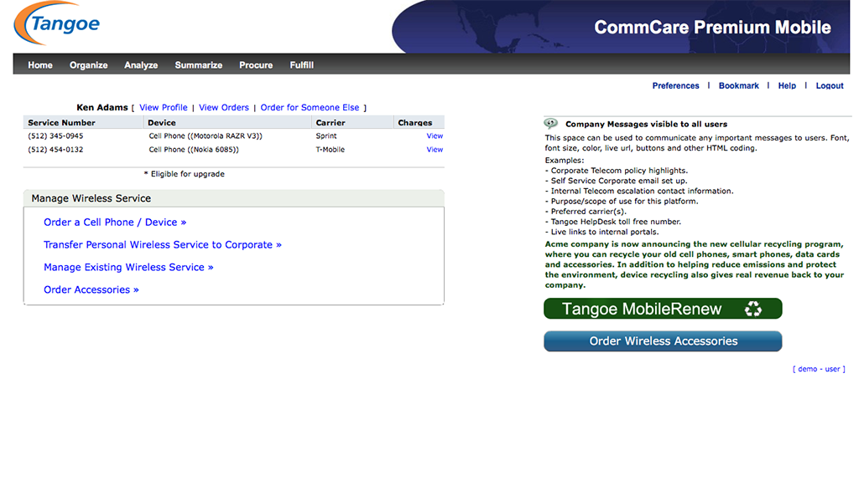
Command (Old)

Slide 20
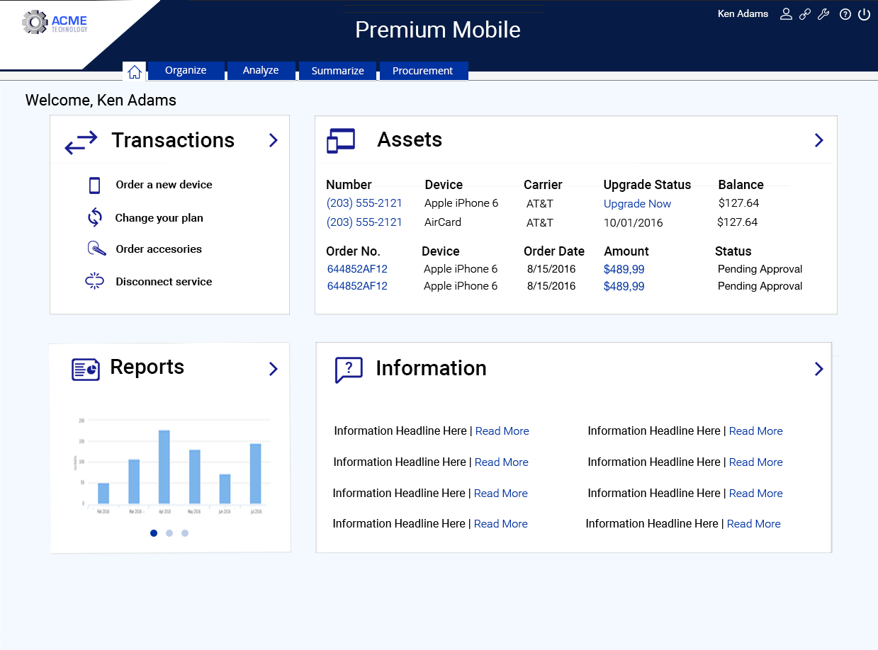
Command (new)

Slide 21
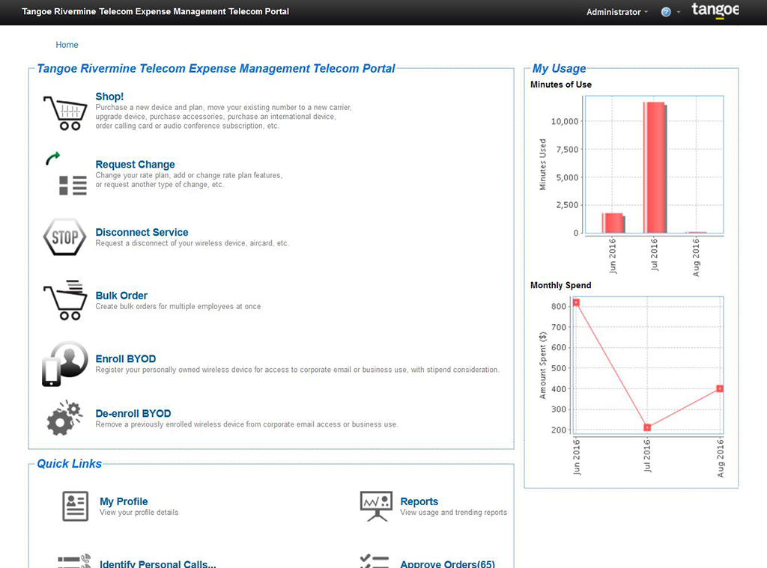
Rivermine (Old)

Slide 22
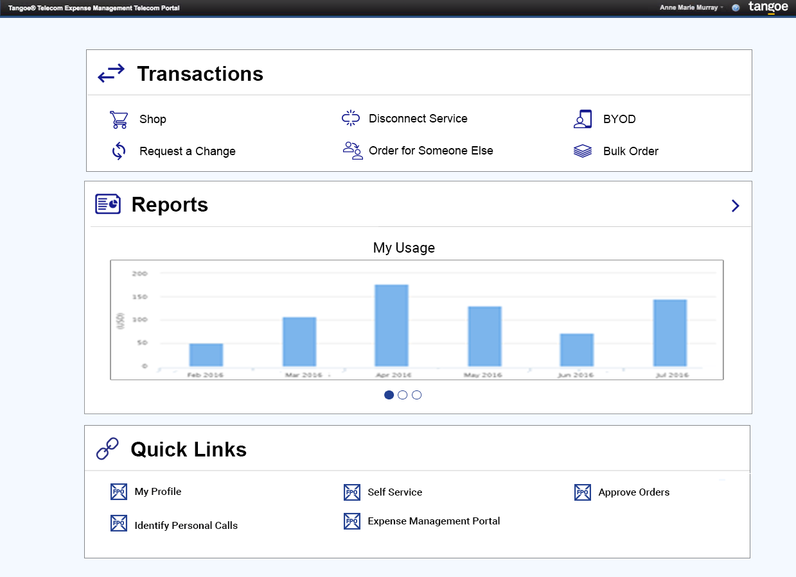
Rivermine (new)

Slide 23
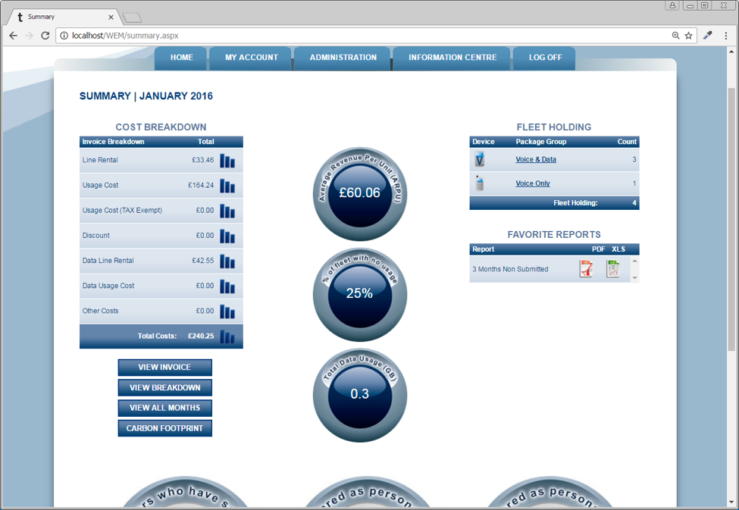
WEM (Old)

Slide 24
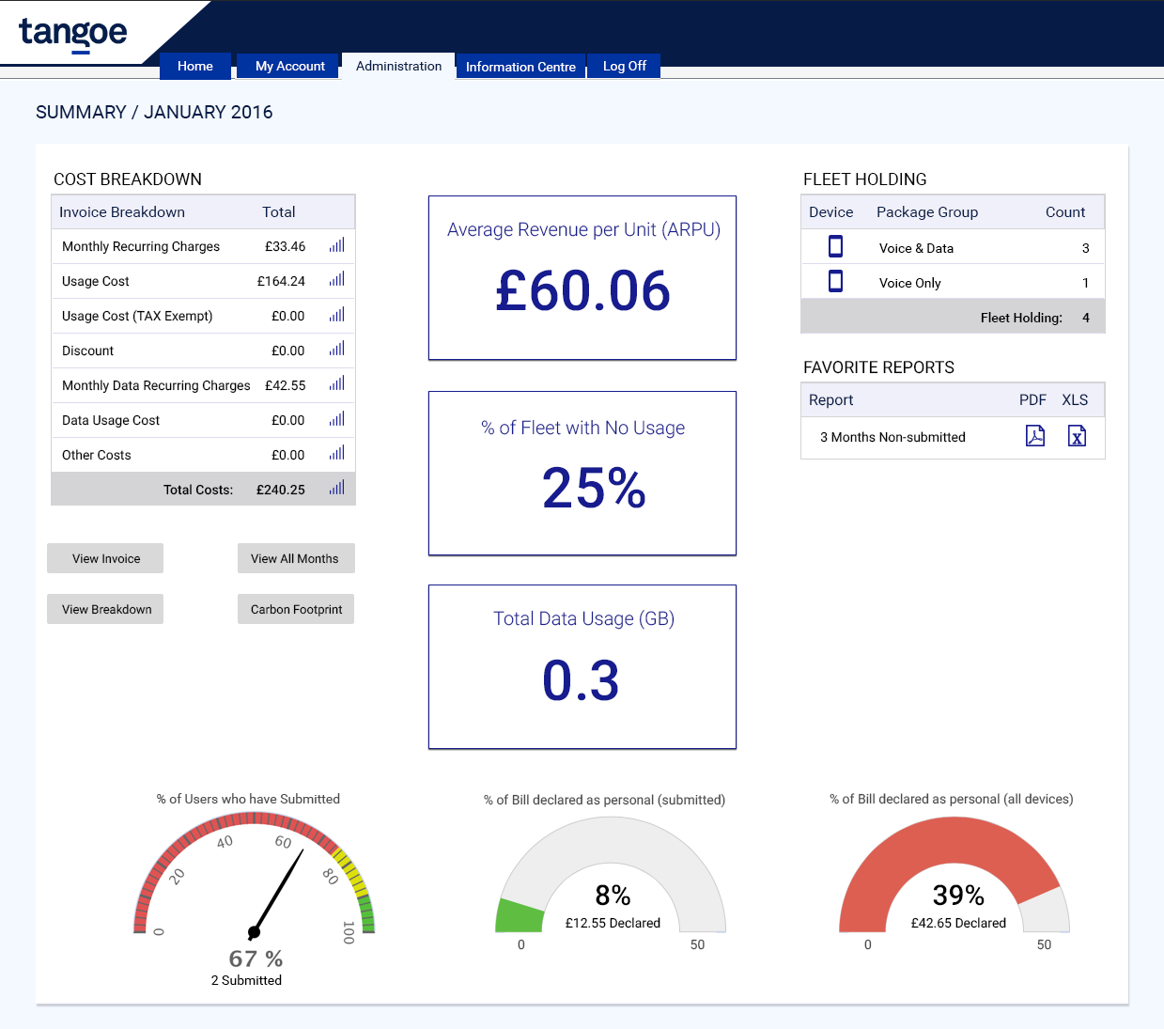
WEM (new)

